Slide 1

Python Programming Bootcamp - Week 2, Day 3
Lists, Tuples, and Loops with Data Structures
Atta Muhammad
attapanhyar@quest.edu.pk
+923331971110
Quaid e Awam University of Engineering, Science and Technology

Slide 2
Learning Objectives
Understand the difference between lists and tuples.
Learn how to create, modify, and access elements in lists and tuples.
Use for loops to iterate over lists and tuples.
Apply basic list operations such as appending, slicing, and indexing.

Slide 3

Introduction to Lists
Definition: A list is a collection of items in a particular order. Lists are mutable, meaning you can change their contents.

Slide 4
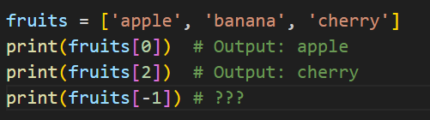
Accessing Elements in a List
Using Indexing:
Lists are zero-indexed, meaning the first item is at index 0.
Example

Slide 5
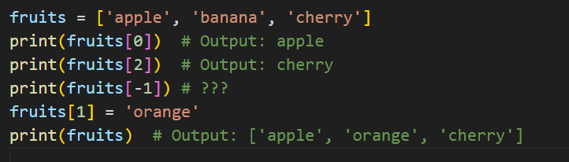
Modifying Elements in a List
Change the Value of an Item:
Lists are mutable, so you can modify elements after creating the list.
Example:

Slide 6

Slicing Lists
Use start:stop to extract a portion of a list.
Example

Slide 7
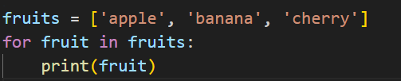
Looping Through a List

Slide 8
Hands-On Exercise 1
Task: Write a program that creates a list of your favourite movies and prints each one using a for loop.

Slide 9

List Operations
Length of a List: Use len() to find out how many items are in a list.

Slide 10
Hands-On Exercise 2
Task: Write a program that checks if a particular movie is in your list of favourite movies.

Slide 11

Introduction to Tuples
Definition: A tuple is a collection of items like a list, but tuples are immutable, meaning their values cannot be changed after creation.

Slide 12
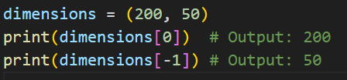
Accessing Elements in a Tuple
Tuples use the same indexing as lists.

Slide 13
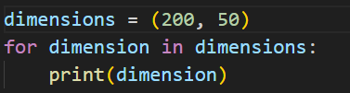
Looping Through a Tuple
You can use for loops to iterate through tuples just like with lists.
Example

Slide 14
Hands-On Exercise 3
Task: Create a tuple that contains the dimensions of a rectangle (length and width) and loop through the tuple to print each value.

Slide 15
Tuples vs Lists
Mutability:
Lists: Mutable – you can change, add, or remove items.
Tuples: Immutable – you cannot modify the contents once a tuple is created.
Use Case:
Use lists when you need a collection of items that can change.
Use tuples when the data is fixed and should not be altered.

Slide 16
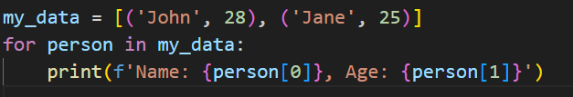
Nesting Lists and Tuples
You can store lists and tuples inside other lists or tuples.

Slide 17
List Comprehensions
What is a List Comprehension?: A concise way to create lists.

Slide 18
Hands-On Group Activity
Task:
Write a program that:
Asks the user to input 5 numbers.
Stores the numbers in a list.
Uses a loop to print each number along with its square.

Slide 19

Common Mistakes
Changing Tuple Elements: Attempting to change an element of a tuple will result in an error.
List Index Errors: Be mindful of index ranges to avoid IndexError by trying to access elements that don’t exist.

Slide 20
Recap and Key Takeaways
Key Takeaways:
Lists are mutable, tuples are immutable.
Use lists when you need to modify the data and tuples when you want to keep the data unchanged.
You can loop through both lists and tuples using for loops.
Slicing and indexing are common operations for accessing elements.
Next Session: Dictionaries and Sets

Slide 21
Q&A and Wrap-Up

Slide 22
MATCH THE SOLUTION 😒

Slide 23
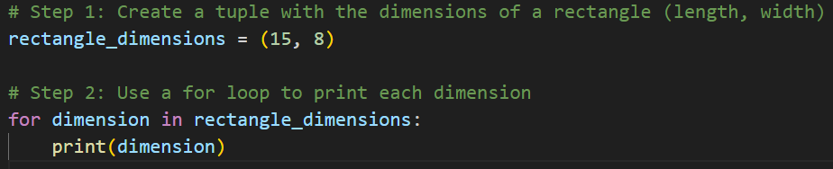
Solution to 🤷‍♂️

Slide 24
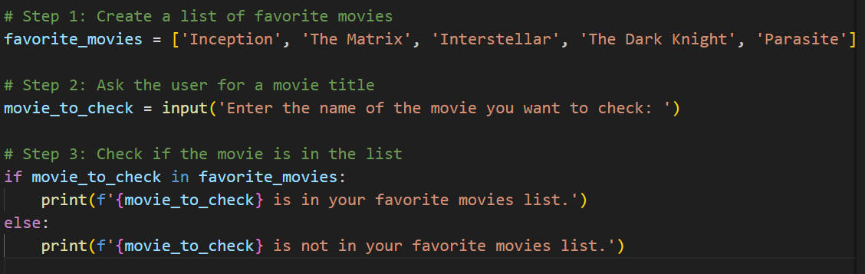
Solution to 🤐

Slide 25
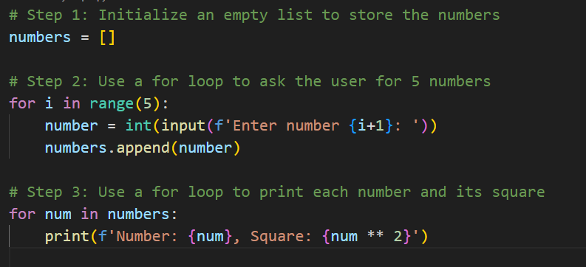
Solution to 🫥

Slide 26
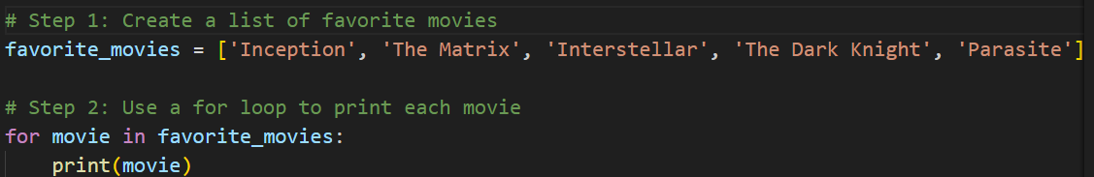
Solution to 🤗

